Slide 1
Microsoft Windows
Device Driver Development
Tom Rethard

Slide 2
Easy as Pie
Obtain the DDK (Device Driver Kit)
Install the DDK
Install debugging tools
Verify the installation
Write the driver
Test the driver
Publish the driver

Slide 3
Obtaining the DDK
Part of Microsoft Developer’s Network (MSDN) subscriptions
Can be ordered separately

Slide 4
Install the DDK
Easy Enough
  Standard Windows install process
  Available for
    Win98
    Win2K
    WinXP

Slide 5
Install the Debugger
32-bit and 64-bit available
Should have been installed with Visual Studio
  You’ll probably want the VC++ compiler

Slide 6
Verifying the Install
Start environment from the Windows DDK menu.
Verify by running
%NTDDK%\src build -cZ
to build the complete set of driver sources.
  Can take more than 30 minutes

Slide 7
New Driver Model
Device driver stack for PnP) device
  a bus driver
  a function driver
  zero to one or more filter drivers
Drivers support
  Plug and Play
  Power Management
  Windows Management Instrumentation (WMI)

Slide 8
Once More, in English
The new system: new type of PnP I/O bus called a toaster bus
  A controller chip on the motherboard initializes and manages the bus.
  The bus has a couple of ports jutting out of the box into which you can plug your toasters.

Slide 9
In Windows NT 4.0
Modify the HAL (hardware abstraction layer) to recognize and initialize the I/O bus during system boot
Provide a set of HAL functions for scanning the bus and accessing the configuration space of the devices by other drivers.
Write drivers for every type of toaster device that loads along with the system
Use the exported HAL functions to scan the bus to
  detect the device
  read the I/O resource requirements
  configure and initialize the device
  These drivers are loaded regardless of whether or not a toaster is plugged in.
If another driver requires the I/O resources claimed by your driver, there is no resource distribution mechanism on Windows NT 4.0 to instruct the driver to relinquish them and use other resources if possible.
If you want to expose instrumentation data or report some exceptional events to user mode, you must provide your own interface and custom applications.
There is no generic interface like WMI and no power management.

Slide 10
Windows 2000/XP
Write a bus driver that has knowledge of:
  bus architecture
  identifies (enumerates) devices on the bus
  reads their resource requirements
  configures them.
Model also makes the OS independent of its I/O bus.
  No help needed from Microsoft if you design a new I/O bus to modify the HAL.
  Write function drivers to control devices connected to the bus.
  Write multiple filter drivers to add or modify the features supported by
    the bus
    a specific device or class of devices.

Slide 11
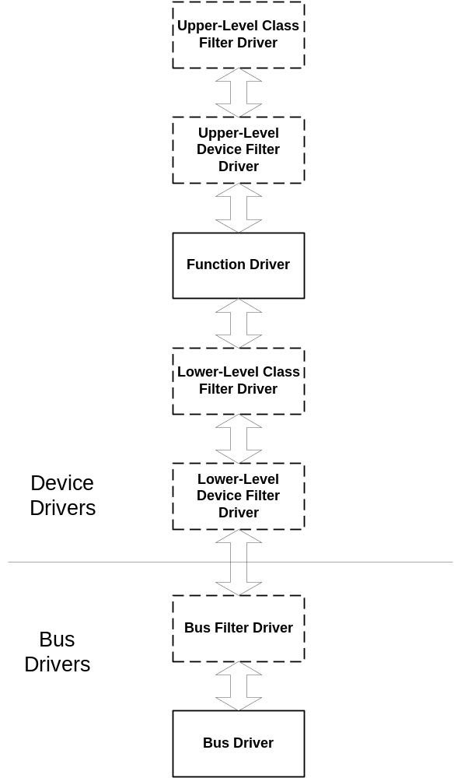
Architecture

Slide 12
Bus Drivers
A bus driver services a bus controller, adapter, or bridge
Microsoft provides bus drivers for most common buses, such as PCI, PnpISA, SCSI, and USB.
Bus drivers are required drivers
  One bus driver for each type of bus on a machine.
  A bus driver can service more than one bus of the same type.
Responsibilities:
  Enumerate the devices on its bus.
  Respond to Plug and Play IRPs and power management IRPs.
  Multiplex access to the bus (for some buses).
  Generically administer the devices on its bus.

Slide 13
Bus Drivers (con’t)
During enumeration, a bus driver identifies the devices on its bus and creates device objects for them. (For information about device objects.
A bus driver performs some operations on behalf of the devices on its bus, including accessing device registers to physically change the power state of a device.
A bus driver does not handle read and write requests for the devices on its bus.
A bus driver acts as the function driver for its controller, adapter, or bridge, and therefore manages device power policy for these components.
A bus driver can be implemented as a driver/minidriver pair, the way a SCSI port/miniport driver pair drives a SCSI host bus adapter (HBA). In such driver pairs, the minidriver is linked to the second driver, which is a DLL

Slide 14
Function Drivers
A function driver is the main driver for a device
Typically written by the device vendor and is required
PnP Manager loads at most one function driver for a device.
Provides the operational interface for its device.
  Typically the function driver handles reads and writes to the device and manages device power policy.
Can be implemented as a driver/minidriver pair, such as a port/miniport driver pair or a class/miniclass driver pair. In such driver pairs, the minidriver is linked to the second driver, which is a DLL.
If a device is being driven in raw mode, it has no function driver and no upper or lower-level filter drivers. All raw-mode I/O is done by the bus driver and optional bus filter drivers.

Slide 15
Filter Drivers
Filter Drivers
Optional drivers that add value to or modify the behavior of a device.
  Bus
  Lower-Level
  Upper-Level

Slide 16
Bus Filter Drivers
Add value to a bus and are supplied by Microsoft or a system OEM.
Optional.
Any number of bus filter drivers for a bus.
For example, implement proprietary enhancements to standard bus hardware.
For devices described by an ACPI BIOS, the Power Manager inserts a Microsoft-supplied ACPI filter (bus filter driver) above the bus driver for each such device. The ACPI filter carries out device power policy and powers on and off devices. The ACPI filter is transparent to other drivers and is not present on non-ACPI machines.

Slide 17
Lower-Level Filter Drivers
Lower-level filter drivers modify the behavior of device hardware.
Typically supplied by IHVs and are optional.
Any number of lower-level filter drivers for a device.
A lower-level device filter driver monitors and/or modifies I/O requests to a particular device.
  Such filters redefine hardware behavior to match expected specifications.
A lower-level class filter driver monitors and/or modifies I/O requests for a class of devices. For example, a lower-level class filter driver for mouse devices could provide acceleration, performing a nonlinear conversion of mouse movement data.

Slide 18
Upper-Level Filter Drivers
Upper-level filter drivers typically provide added-value features for a device.
Usually provided by IHVs and are optional.
There can be any number of upper-level filter drivers for a device.
An upper-level device filter driver adds value for a particular device.
  For example, an upper-level device filter driver for a keyboard could enforce additional security checks.
An upper-level class filter driver adds value for all devices of a particular class.

Slide 19
Co-Installer
A co-installer is a user-mode Win32 DLL that writes additional configuration information to the registry, or performs other installation tasks requiring information that is not available when an INF is written.
A co-installer might do some or all of the following:
  Handle one or more of the device installation function codes (DIF codes) received by the co-installer entry point function.
  Perform operations before the associated class or device installer is called, after the class or device installer is called, or both
  Provide "finish install" pages to obtain device parameters that are required so the device can operate, or to ask if device-specific applications should be installed.
  Provide device property pages, which are displayed by the Device Manager so users can modify device parameters.

Slide 20
Co-Installer (con’t)
When called for post-processing, a co-installer must check the InstallResult member of COINSTALLER_CONTEXT_DATA. If its value is not NO_ERROR, the co-installer must do any necessary clean up operations and return an appropriate value for InstallResult.
Co-installers are sometimes used to obtain information from the user. Such information
  additional device parameters (such as a modem's dialing properties)
  whether the user wants device-specific applications installed.
  can create user interfaces by providing "finish install" pages and by providing device property pages.
  Setup displays "finish install" pages at the end of the installation (within the Found New Hardware, Hardware Update, or Add Hardware Wizard, which require administrator privilege). The Device Manager displays property pages, and allows users with administrator privilege to modify parameters displayed on these pages.

Slide 21
Class Installer Interface
Every class installer exports a class installer function. The default name for the function is ClassInstall. Setup API calls this function whenever it needs the class installer to carry out a specific installation task for a device of its setup class.
The prototype for the installer function is as follows:
  typedef DWORD (CALLBACK* CLASS_INSTALL_PROC) ( IN DI_FUNCTION InstallFunction, IN HDEVINFO DeviceInfoSet, IN PSP_DEVINFO_DATA DeviceInfoData /* optional */ );
The class installer function receives two or three arguments:
  a device installation function code, which identifies the installation request to perform
  a handle to a device information set
  optionally, a pointer to an SP_DEVINFO_DATA structure that contains information about the device to install

Slide 22
Class Installer (con’t)
A class installer returns one of the following values:
  ERROR_DI_DO_DEFAULT
    which instructs Setup to perform the default action for the DIF request
    not really an error, just a valid return value
    indicates that the class installer possibly performed some actions that filter or augment the installation action, but the class installer's actions do not replace the default action.
    If you know that a given DIF request has no default action, you should still return ERROR_DI_DO_DEFAULT. The DIF request might have a default action in a future release of the operating system.
  A Win32 error
    A class installer can return an appropriate Win32 error.
  NO_ERROR
    returns NO_ERROR if it determines that it has fully completed the device installation task, including calling any default handler or superseding the default operation.

Slide 23
The Toaster Sample
Provides a starting point for Windows® 2000/XP driver development.
Contains annotated code to illustrate functionality of
  bus driver
  function driver
  assorted class, device, and bus filter drivers
  class-installer
  device-specific co-installer
for a hypothetical Toaster bus and its devices.

Slide 24
Sample Code
Defines new class of devices called the TOASTER class
Includes
  a bus driver,
  function driver,
  all possible class, device, and bus filter drivers for this hypothetical TOASTER bus and its devices
Sample of coinstaller DLL to show
  how to parse a custom section of an INF file
  perform some special operations before and after the installation of a device
  how to create FriendlyName for a device.
The function and bus driver also show how you can provide power manager and WMI support.

Slide 25
Introduction
Package contains the following directories:
  Bus
  Func
  Filter
  Exe
  Inc
  Coinstaller
  Classinstaller
  Inf
  Toastmon
  Toastpkg

Slide 26
bus
Source code of the toaster bus driver (Busenum.sys).
  driver services the TOASTER bus controller, enumerate devices that are plugged in, and perform bus-level power management. The bus driver supports D0 and D3 power states. It also has a WMI interface. func
Source code of the function driver (Toaster.sys) for standard toaster devices.
  owns the power policy for the toaster device and supports D0 and D3 power states.
  provides WMI interface.inc
header files that are shared among drivers and applications.

Slide 27
exe
Contains three subdirectories notify, enum, and toast, with files to produce notify.exe, enum.exe and toast.exe (user-mode console applications):
Enum.exe is a user-mode enumerator, a simple console application.
  Because the toaster bus is not real, you need to have a mechanism to tell the bus driver when you plug in, unplug, and eject devices from the system.
  Iit’s written as a control panel applet for non-Plug and Play (legacy) devices.
  For example, game.cpl. Usage: Enum [-a SerialNo] Plugs in a device. SerialNo. must be greater than zero.
  [-r SerialNo or 0] Unplugs device(s) - specify 0 to unplug all the devices enumerated so far.
  [-e SerialNo or 0] Ejects device(s) - specify 0 to eject all the devices enumerated so far.
  By design every toaster device will have a globally unique serial number.
Toast.exe:
  user-mode console application to control the toaster.
Notify.exe:
  GUI application not only combines the functionality of Enum.exe and toast.exe but also shows how to handle PnP notification in user-mode.

Slide 28
filter
This directory contains six different subdirectories, each producing one of the following drivers from a common source file (filter.c):
Class upper filter (clsupper.sys)
Class lower filter (clslower.sys)
Device upper filter (devupper.sys)
Device lower filter (devlower.sys)
Bus FDO upper filter (bfdoupr.sys)
Bus FDO lower filter (bfdolwr.sys)

Slide 29
coinstaller
source code of the device-specific coinstaller (tostrco1.dll).
  demonstrates how to create a FriendlyName for a device based on its unique instance id.
  bus driver provides the serial number in the UINumber field of the device capabilities.
  FriendlyName is required to uniquely identify multiple devices of the same interface class
  coinstaller also shows how to open an INF file and parse a custom section.

Slide 30
Classinstaller
source code of the class-installer (tostrcls.dll).
dummy class-installer included to provide a class icon for all the TOASTER Class devices
copied to the system32 directory when the class is installed for the first time in the system.

Slide 31
inf
bus.inf:
  installs the basenum.sys and sets up the registry.
toaster.inf:
  creates Toaster class, installs toaster.sys and sets up the registry.
toastco.inf:
  functionally similar to toaster.inf but also installs the coinstaller.
busf.inf and toasterf.inf:
  files are functionally similar to the above INF files but also install all the previously mentioned filter drivers.
filter.inf:
  installs just a device upper filter for the toaster device.

Slide 32
toastmon
toastmon.sys.
Toastpkg
  sources for an integrated device installation solution

Slide 33
BUILDING THE SAMPLE
set up the DDK environment on the host machine.
Run the build –ceZ command in the Toaster directory to build busenum.sys, toaster.sys, enum.exe, toast.exe, tostrco1.dll, tostrcls.dll, and the six filter drivers mentioned previously.
Copy all the .sys, .exe, .dll, a bus driver INF file (bus.inf), and a toaster device INF file (toastco.inf) to a floppy disk or a temporary directory on the target system.

Slide 34
Web Sites
The Driver Development Kit Web Site: http://www.microsoft.com/ddk.
The Hardware Development Web Site: http://www.microsoft.com/hwdev
The Hardware Testing Web Site - WHQL: http://www.microsoft.com/hwtest
MSDN™, the Microsoft Developers Network: http://msdn.microsoft.com

